Slide 1
Power Players & Political Shifts: Adapting Advocacy for Trump 2.0
April 9, 2025

Slide 2
Today’s Speakers
Kate Ackley
Angela Greiling Keane
Lobbying and influence reporter Bloomberg Government
News Director Bloomberg Government
Missy Edwards
Bryan Lanza
Strategic Partner Missy Edwards Strategies
Partner Mercury
Paul Thornell
Partner Mehlman Consulting

Slide 3
Today’s Agenda
How Trump’s second term reset Washington
A look at lobbying in 2024
Trump tariffs & trade wars
Tax and spending reconciliation debate
DOGE cuts
AI, tech, and more
Q&A
To contact the editors responsible: Loren Duggan at lduggan@bloomberrdindustry.com

Slide 4
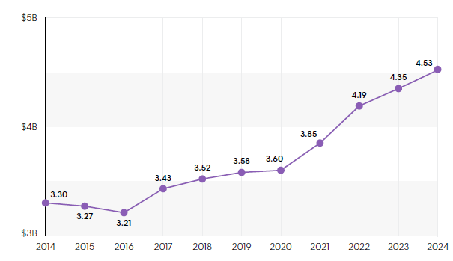
A Decade of Influence Industry Growth
Note: Amounts show are in billions and have been rounded
Source: Bloomberg Government analysis of Lobbying Disclosure Act filings as of March 18

Slide 5
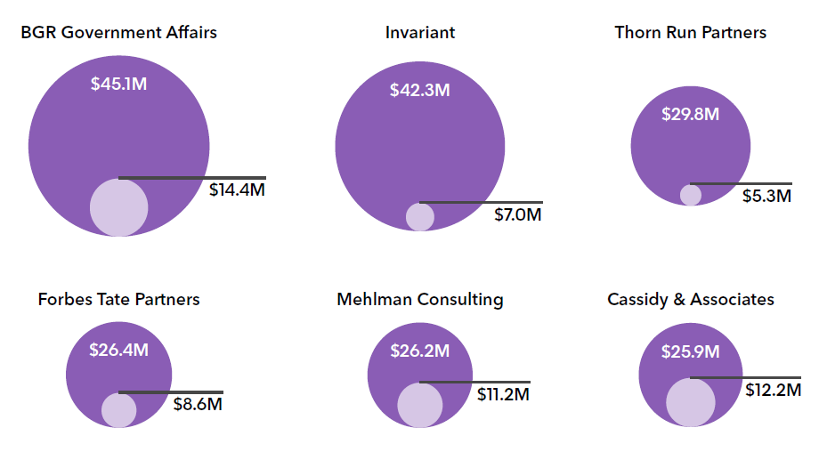
Firms With Largest Revenue, Compared With 2014 Performance
Source: Bloomberg Government analysis of Lobbying Disclosure Act filings. This data includes firms with
revenues of $1 million or more in 2024 and at least four quarters of filings in 2014.

Slide 6
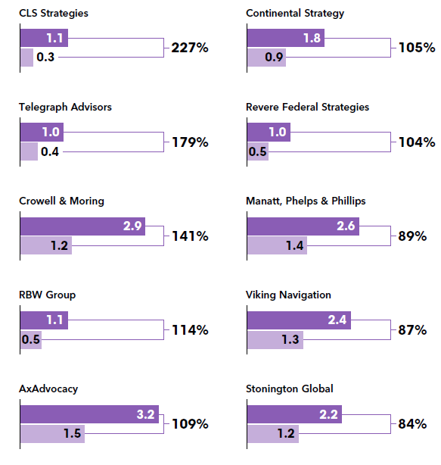
Largest One Year Gains Year-over-year revenue change for firms that reported four quarters of activity and at least $1 million in revenue in 2024
Source: Bloomberg Government analysis of Lobbying Disclosure Act filings.

Slide 7
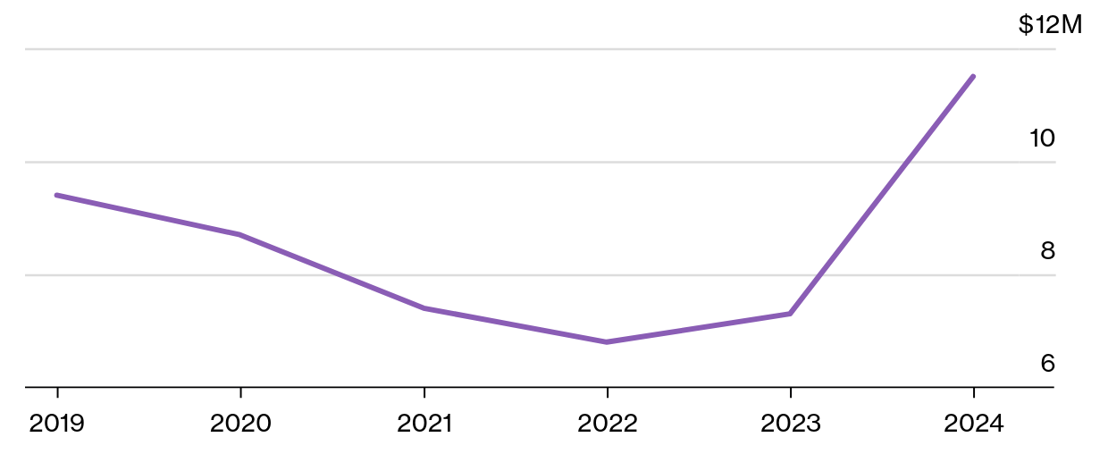
Mercury’s Business Rising with Trump Ties, Ex-Lawmakers on Board
Source: Bloomberg Government data

Slide 8
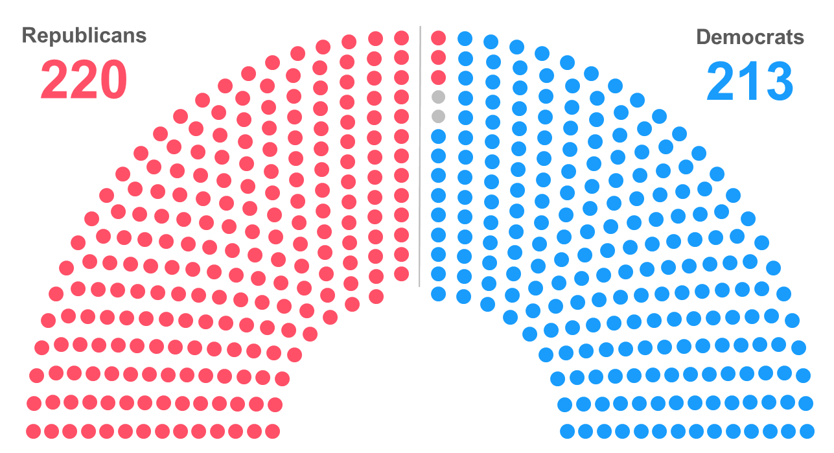
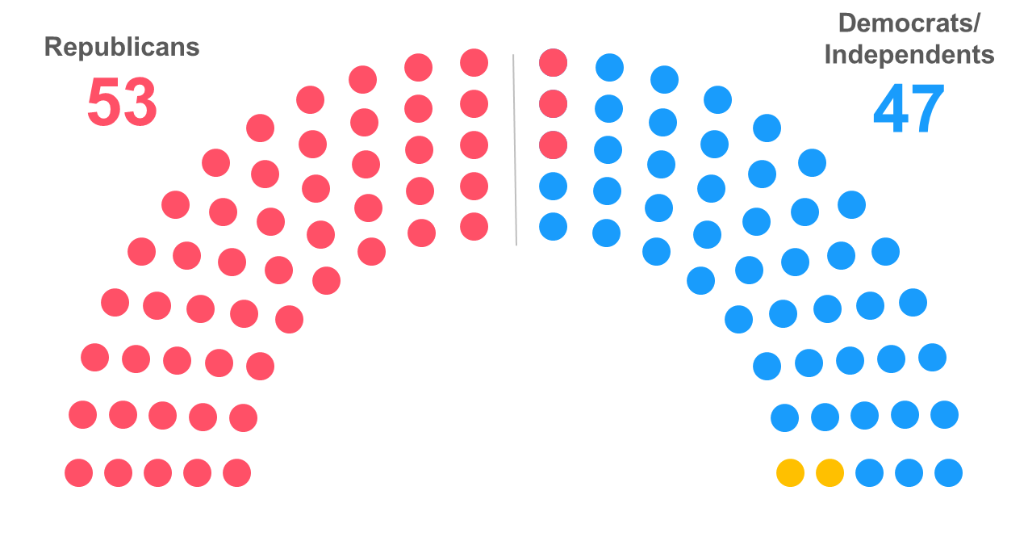
Republicans Navigate Slim Margins in House, Senate

Slide 9
Congress’s Budget Bills Ride on Two Tracks
Graphic by Jonathan Hutarte

Slide 10
Budget Reconciliation Process
Budget Rules
Chambers adopt same budget resolution with reconciliation instructions
Expedited procedures, simple majority vote in Senate; “vote-a-rama” on unlimited amendments
Provisions must be directly related to budget to comply with “Byrd rule”
Any senator can raise point of order aiming to strike “extraneous matters” that violate the rule
Presiding officer decides if point of order is sustained based on advice of parliamentarian
Senate usually follows parliamentarian’s rulings to ensure provisions comply with the process
60 votes needed to waive the point of order to keep a provision in the bill
PROCESS FOR BUDGET TOOL
Committees report reconciliation legislation
Extraneous matters include provisions that:
Don’t affect outlays or revenue, or have effects that are “merely incidental” to the nonbudgetary effects
Don’t comply with the reconciliation instructions
Increase the deficit beyond the budget window
Affect Social Security
Reconciliation bill subject to expedited procedures, simple majority in Senate
“Vote-a-rama” on unlimited amendments
Sources: “Congressional Budget Resolution: Frequently Asked Questions,” “The Budget Reconciliation Process: Stages of Consideration,” CRS

Slide 11
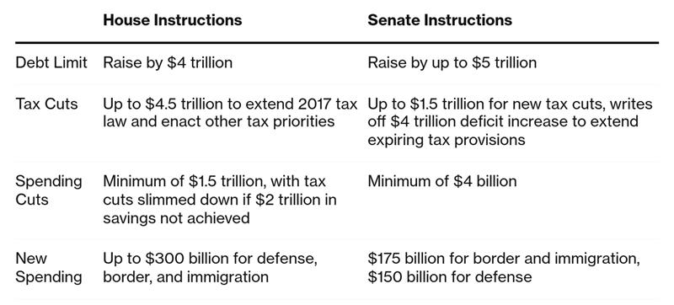
House, Senate Instructions Depart in Budget Resolution
Source: Senate version of H. Con. Res. 14

Slide 12
Debt Limit Adds Time Crunch to GOP Budget Plan
January: Debt limit reinstated; Treasury begins taking extraordinary measures
May to October: Treasury exhausts borrowing authority according to projections; timeline uncertain due to fluctuations in revenue and spending
Debt Limit Dynamics
GOP leaders want to raise debt limit through reconciliation to avoid relying on Democratic votes
House Minority Leader Hakeem Jeffries (D-N.Y.) indicated Democrats won’t help GOP raise the debt limit without concessions
Senate plan would allow the debt-limit hike to be voted on separately if reconciliation doesn’t get done in time
Thune previously wanted a separate debt limit bill to put Democrats on the record
US debt default would be unprecedented and could rock world economy
Jan Feb Mar April May June July Aug Sept Oct
Early April: GOP goal to get budget resolution adopted by both chambers; House and Senate set for two-week recess after April 11
May 9: Deadline for committees to finalize instructions; debt-limit bill due May 16 in Senate
Source: BGOV OnPoint: Debt Limit Deadline Accelerates GOP Budget Plans

Slide 13
Roundup of Trump’s Active and Proposed Tariffs
Currently in Effect
Other Pending Proposals
Between 10% and 50% reciprocal tariffs on more than 180 countries, with exemptions for:
Products from Canada and Mexico and those already subject to tariffs, such as steel and automobiles
Pharmaceuticals, semiconductors, copper, and lumber, which could face future tariffs
25% tariffs on pharmaceutical drugs and semiconductors
Unspecified tariff on timber, lumber, and copper, which Commerce is probing as national security threats
25% tariff on steel, aluminum, and vehicles and automotive parts, with exceptions for USMCA-compliant parts
20% tariff on Chinese goods in addition to tariffs still in effect from Trump’s first term, which is in addition to latest reciprocal tariff
Trump also closed the “de minimis” loophole for low-value goods from China, Hong Kong
25% tariff on imports from countries that buy oil from Venezuela, mainly affecting China
200% tariff on European alcohol if the EU enacts tariffs on US whiskey
25% tariff on non-USMCA Canadian and Mexican goods, with a lower 10% tariff for Canadian energy and potash from both countries
Unspecified tariffs on goods from countries that buy oil from Russia if it rejects ceasefire deal with Ukraine
Ро с с и я
Note: USMCA — United States-Canada-Mexico Agreement, which replaced NAFTA and was negotiated and ratified during Trump’s first term.
Sources: White House April 2 executive order; “Tracking Every Trump Tariff and Its Economic Effect,” Bloomberg News; “Trump’s Trade War Timeline 2.0,” Peterson Institute for International Economics

Slide 14
Trump Slaps Reciprocal Tariffs on Most of the World
Reciprocal tariff rates set April 2 by Trump for the US’s top trading partners
Canada and Mexico weren’t included because they’re subject to separate tariffs
United Kingdom
10%
China
34%
South Korea
25%
EU
20%
Taiwan
32%
Switzerland
31%
Vietnam
46%
Japan
24%
India
26%

Slide 15
Turn to Bloomberg Government for More on Lobbying

Slide 16
Q&A

